Slide 1
Lecture 3
Balance equations for reactive scalars
Eddy-Beak-up Model and Eddy Dissipation Model
Transported pdf models
The laminar flamelet concept
The BML model and the Coherent Flame Model
Combustion Modelling by LES
3.-1

Slide 2
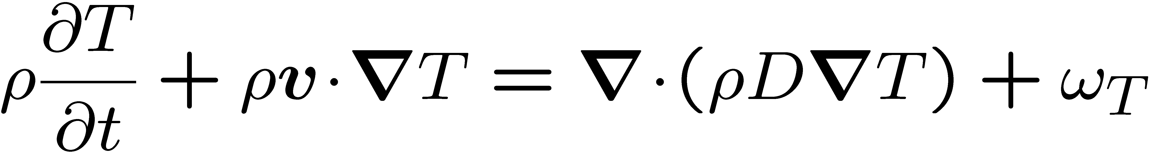
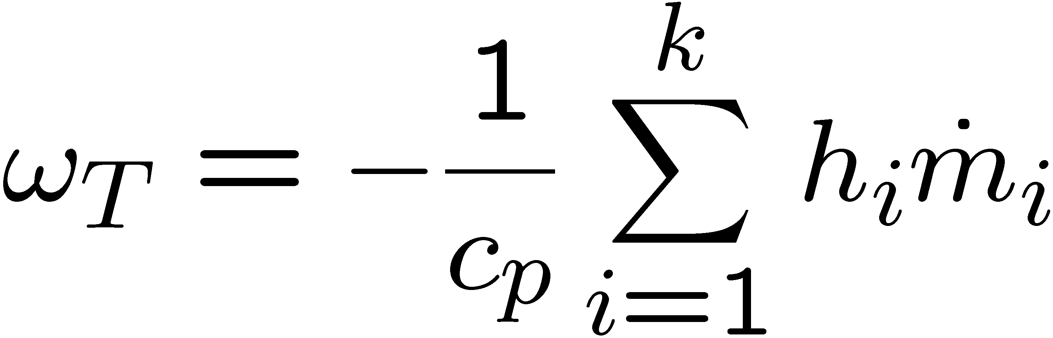
Balance Equations for Reactive Scalars
For simplicity, we will assume that the specific heat capacities c_{p,i} are all equal and constant, the pressure is constant and the heat transfer due to radiation is neglected.
Then the temperature equation for unity Lewis number becomes
The heat release due to chemical reactions is written as
3.-2

Slide 3
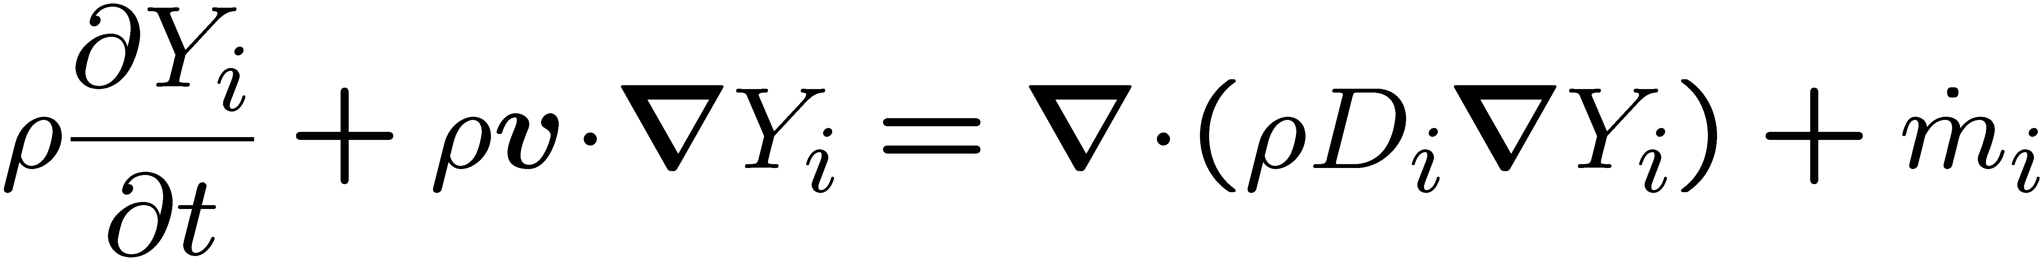
This form of the temperature equation is similar to that for the mass fractions of
species i , which becomes with the binary diffusion approximation
If, in addition, a one-step reaction and equal diffusivities (D_{i}=D) were assumed, coupling relations between the temperature and the species mass fractions can be derived (cf. Williams, 1985).
These assumptions are often used in mathematical analyzes of combustion problems.
3.-3

Slide 4
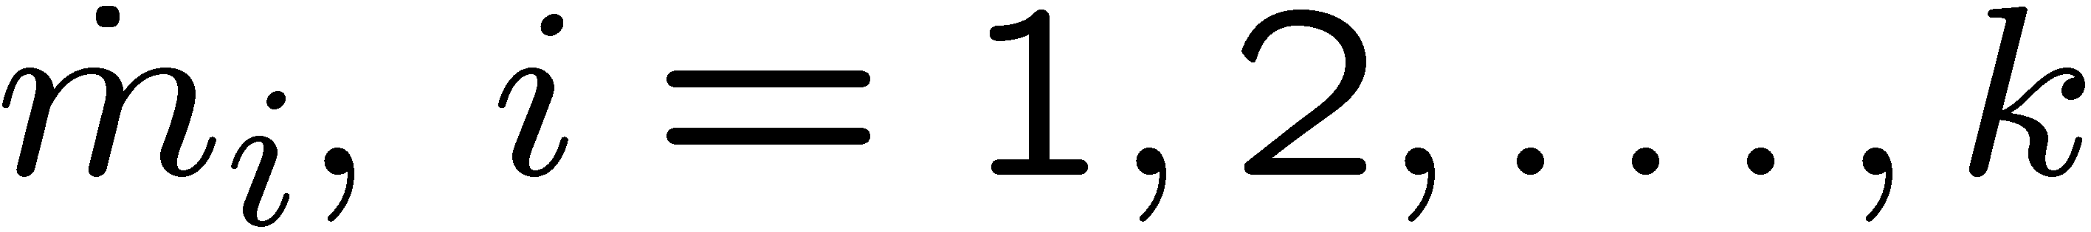
In the following we will use the term "reactive scalars" for the mass fraction of
all chemical species and temperature and introduce the vector
Here k is the number of reactive species.
For simplicity of notation, the balance equation for the reactive scalar ψ_{i} will be written
where i=1,2,… ,k+1. The diffusivities D_{i} (i=1,2,… ,k) are the mass diffusivities for the species and D_{k+1}=D denotes the thermal diffusivity.
Similarly, σ_{i} (i=1,2,… ,k) are the species source terms and
σ_{k+1} is defined as ω_{T} .
The chemical source term will also be written as s_{i}=ρS_{i}
3.-4

Slide 5
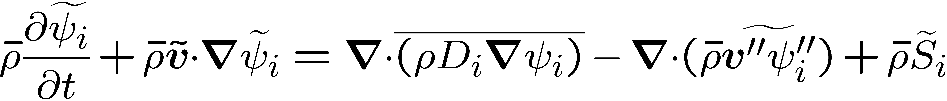
Moment Methods for Reactive Scalars
Favre averaged equations for the mean and the variance of the reactive scalars can be derived by splitting ψ_{i}(x,t) into a Favre mean and a fluctuation
When this is introduced into
one obtains in a similar way as for the momentum equation after averaging
In this equation the terms on the l.h.s. are closed, while those on the r.h.s. must be modeled.
3.-5

Slide 6
In high Reynolds number flows the molecular transport term containing the molecular
diffusivities D_{i} are small and can be neglected.
Closure is required for the second term on the r.h.s., the turbulent transport term, and for the last term, the mean chemical source term.
The modeling of the mean chemical source term has often been considered as the main problem of moment methods in turbulent combustion.
In order to discuss the difficulties associated with the closure of this term, we assume that coupling relations exist between the chemical species and the temperature.
3.-6

Slide 7
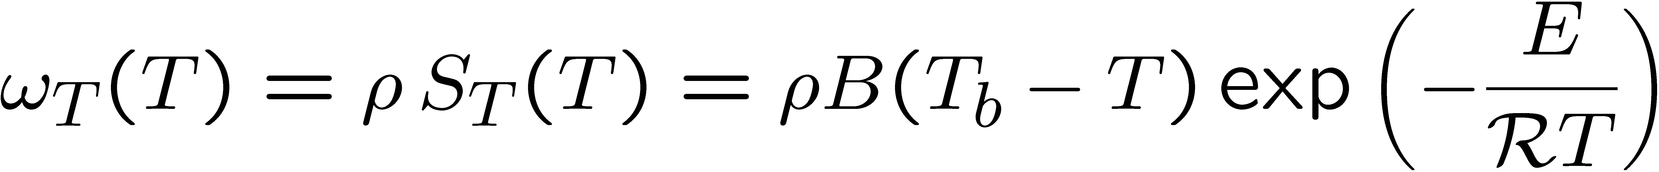
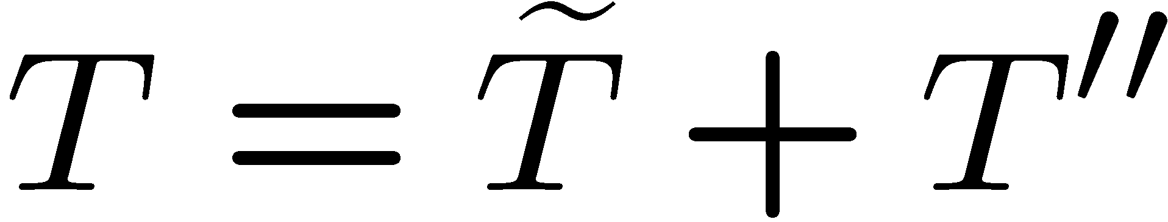
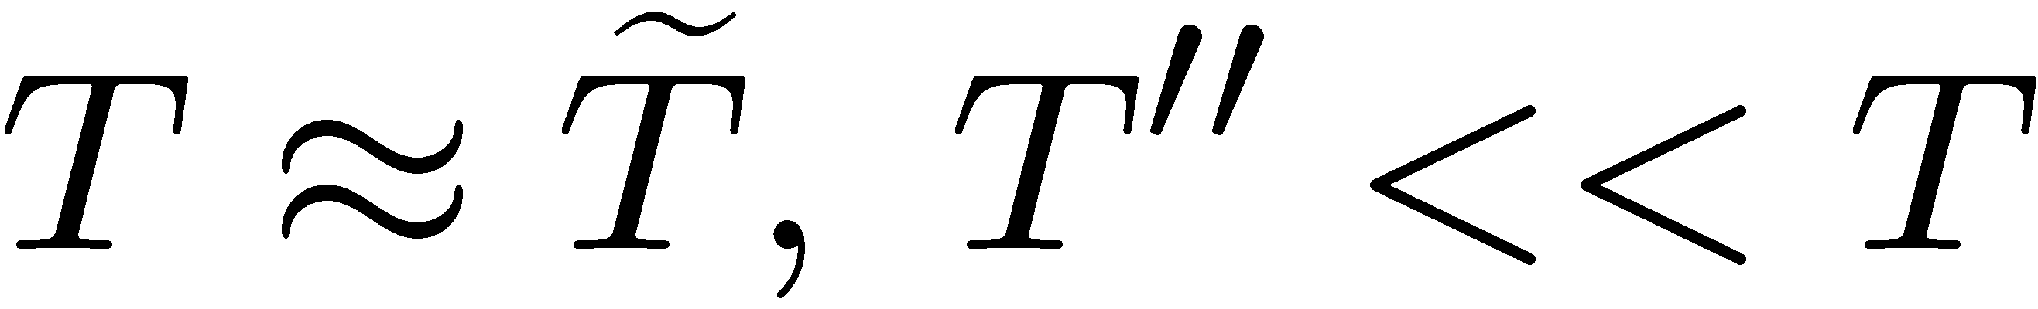
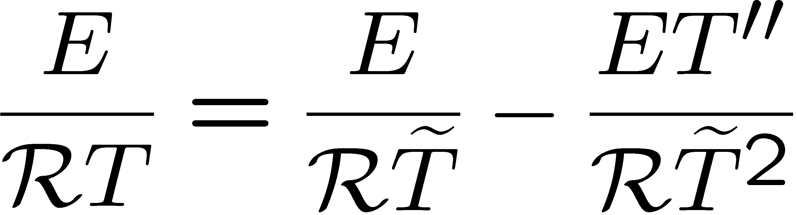
As noted before, such coupling relations can easily be derived for the case of a one step reaction and equal diffusivities.
With this assumption we consider the following form of the heat release rate
Here B contains the frequency factor and the heat of reaction, T_{b} is the adiabatic flame temperature, E the activation energy.
Introducing the argument of the exponential term may be expanded around as
3.-7

Slide 8
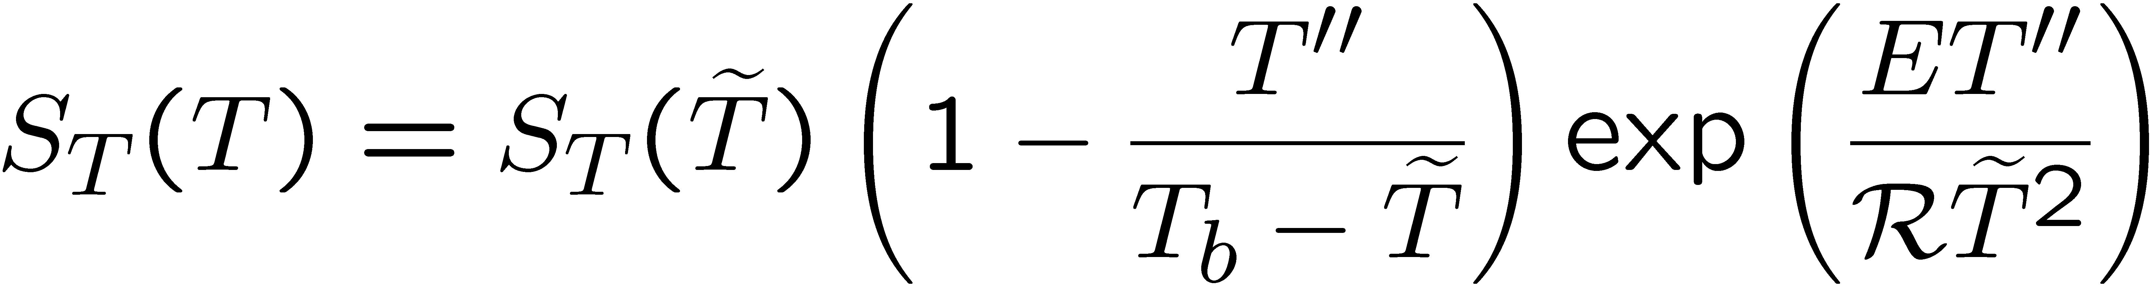
If the expansion is also introduced into the preexponential term, the quantity S_{T} becomes
Typically, in the reaction zone of a flame
Therefore the exponential term causes enhanced fluctuations of the chemical source term maround its mean value evaluated with the mean temperature.
It may be concluded that moment methods for reactive scalars will fail due to the strong nonlinearity of the chemical source term.
3.-8

Slide 9
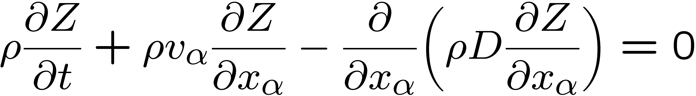
Scalar Transport and Dissipation of Mixture Fraction
The equation for the mixture fraction
does not contain a chemical source term, since elements are conserved in chemical reactions.
We assume the mixture fraction Z to be given in the flow field as a function of space and time: Z=Z(x_{α},t)
3.-9

Slide 10
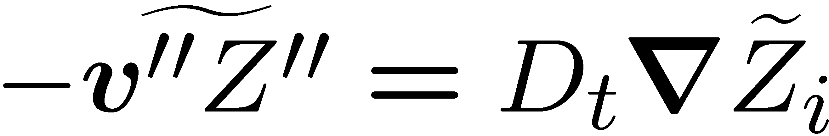
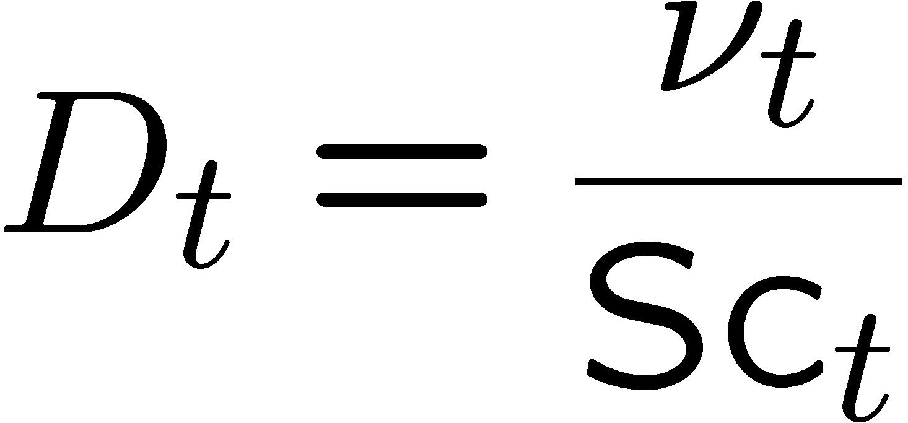
It is general practice in turbulent combustion to employ the gradient transport assumption for non-reacting scalars.
The scalar flux then takes the form
Here D_{t} is a turbulent diffusivity which is modeled by analogy to the eddy viscosity as
where Sc_{t} is a turbulent Schmidt number.
3.-10

Slide 11
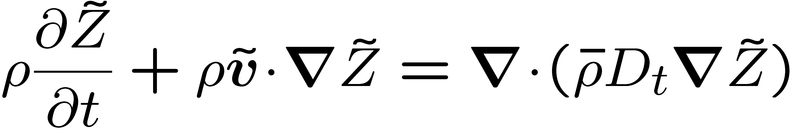
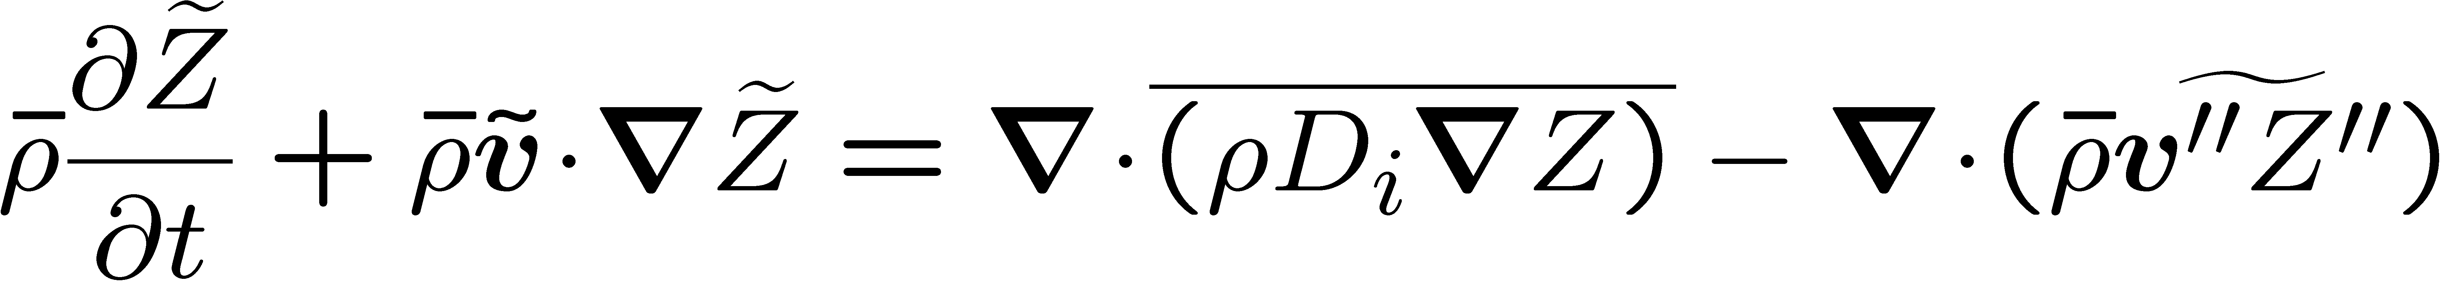
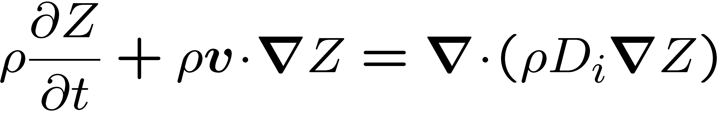
The equation for the mean mixture fraction then reads
where the molecular term has been neglected.
In order to derive an equation for mean mixture fraction variance we first must derive an equation for the fluctuation Z '' by subtracting
from
we obtain:
3.-11

Slide 12
If derivatives of ρ and D and their mean values are neglected for simplicity, the first two terms on the r.h.s. of
can be combined to obtain a term proportional to D_{i} ΔZ ''.
Introducing this and multiplying the equation by 2ρZ '' one obtains an equation for Z ''².
With the use of the continuity equation and averaging one obtains
3.-12

Slide 13
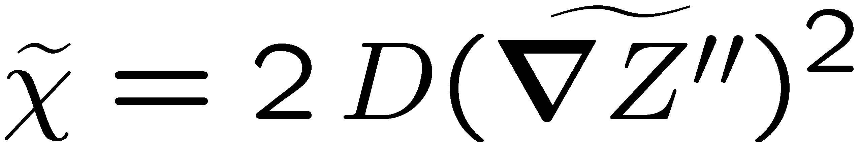
As before, the terms on the r.h.s. describe the local change and convection.
The first term on the r.h.s. is the turbulent transport term.
The second term on the r.h.s. accounts for the production of scalars fluctuations.
The mean molecular transport term has been neglected for simplicity but the molecular diffusivity still appears in the dissipation term.
The Favre scalar dissipation rate is defined as
3.-13

Slide 14
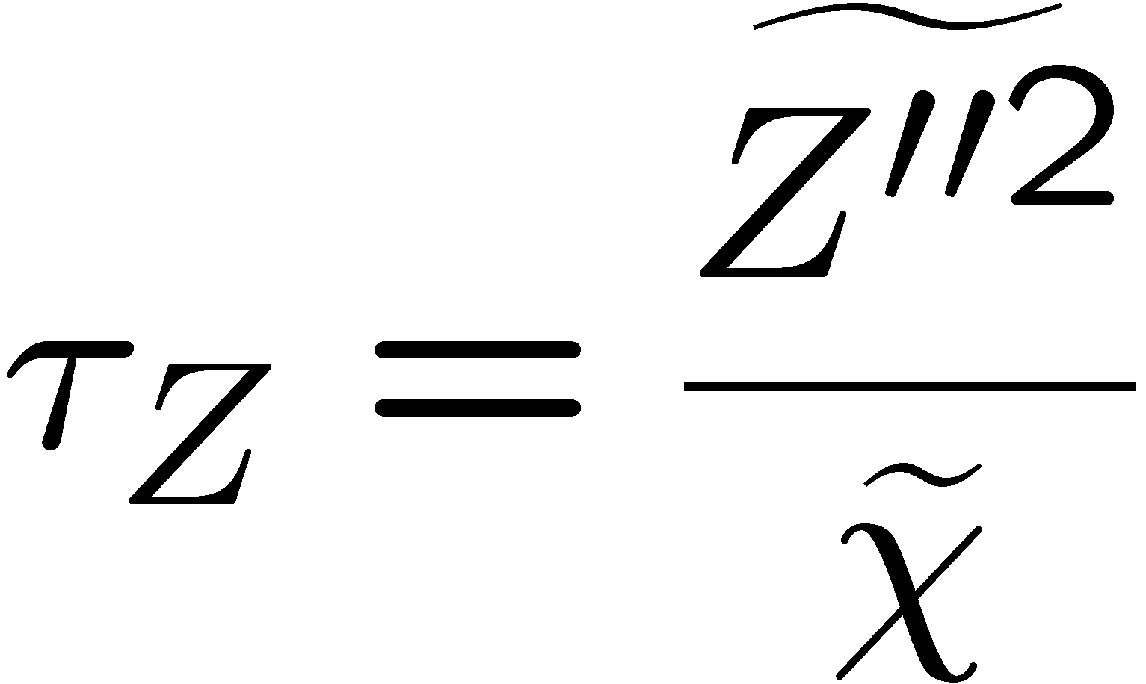
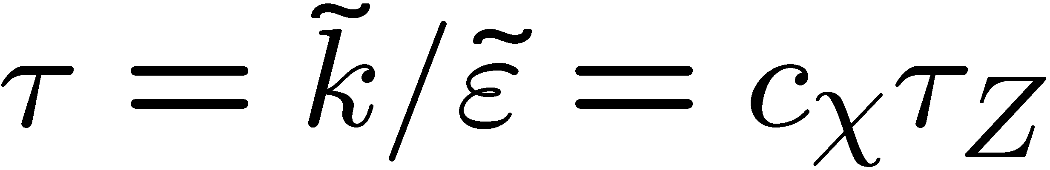
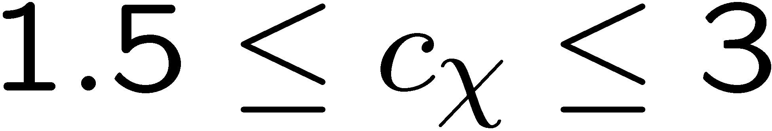
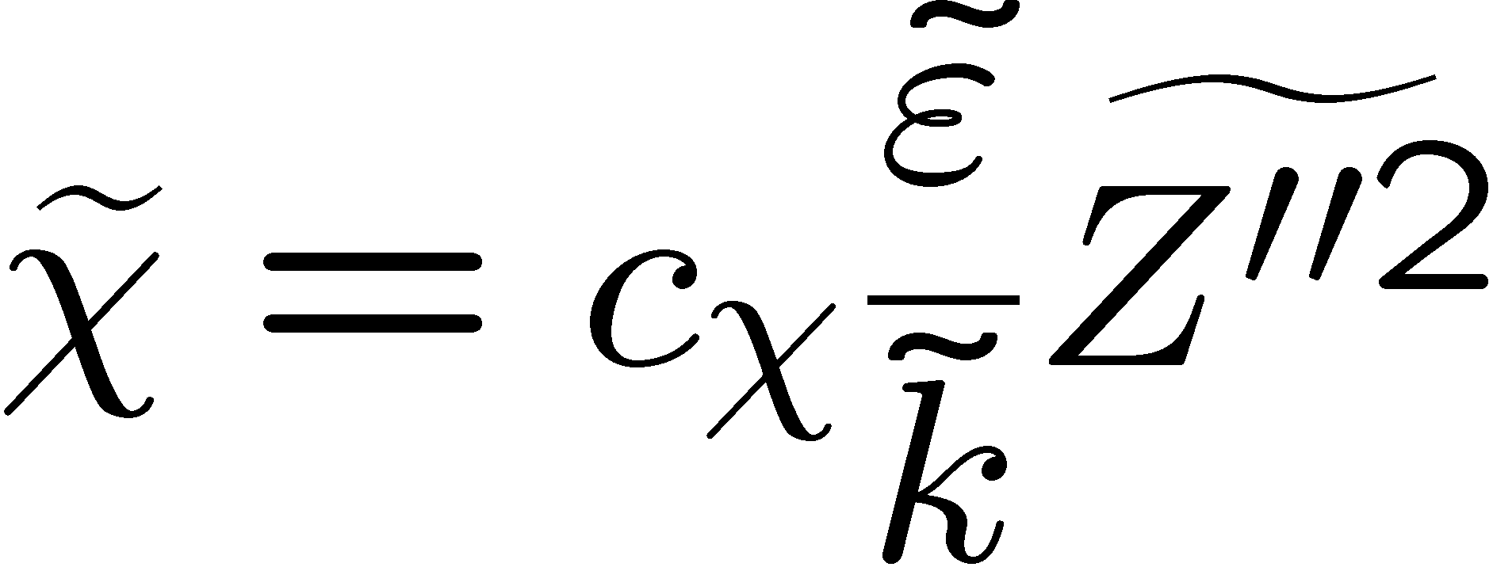
An integral scalar time scale can be defined by
It is often set proportional to the flow time
The constant of proportionality c_{χ} is of order unity but varies:
A value c_{χ} = 2.0 is often used.
Combining and
leads to the model
3.-14

Slide 15
The Eddy Break Up and the Eddy Dissipation Model
An early attempt to provide a closure for the chemical source term is due to
Spalding (1971).
Turbulent mixing may be viewed as a cascade process from the integral down to the molecular scales,
the cascade process also controls the chemical reactions as long as mixing rather than reaction is the rate determining process.
This model was called the Eddy-Break-Up model (EBU).
3.-15

Slide 16
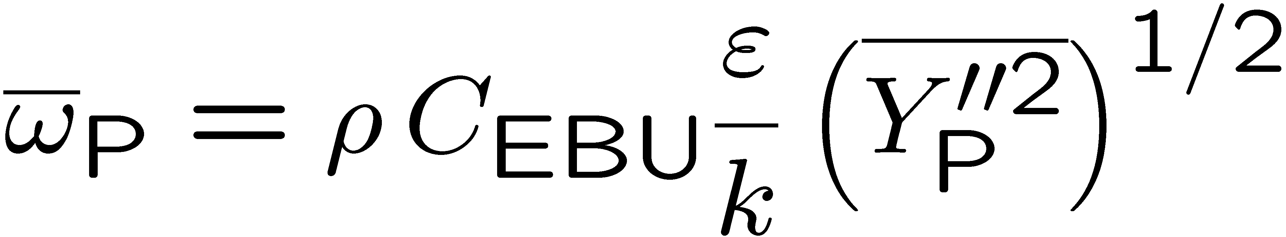
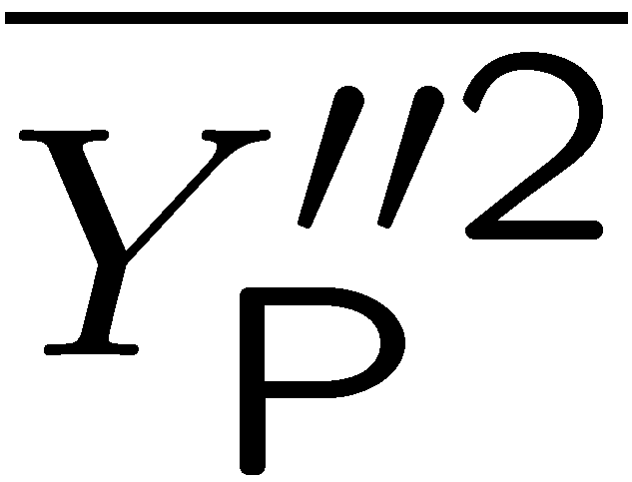
The turbulent mean reaction rate of products was expressed as
is the variance of the product mass fraction and C_{EBU} is the Eddy-Break-Up constant.
This model has been modified by Magnussen and Hjertager (1977) who replaced
simply by the mean mass fraction of the deficient species
(fuel for lean or oxygen for rich mixtures)
calling it the Eddy Dissipation Model (EDM).
3.-16

Slide 17
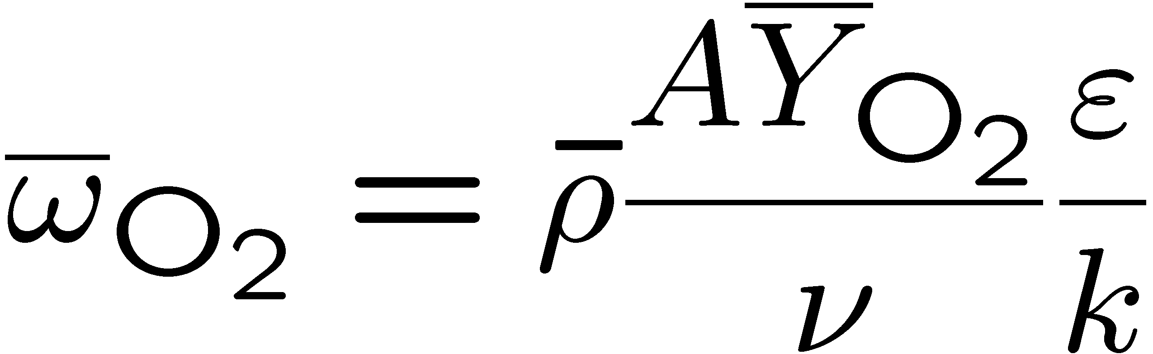
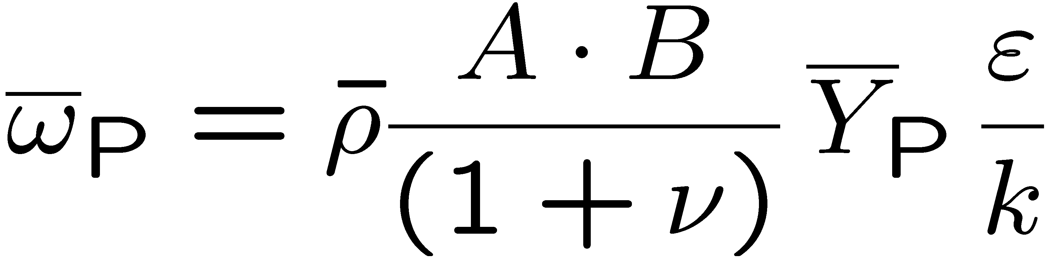
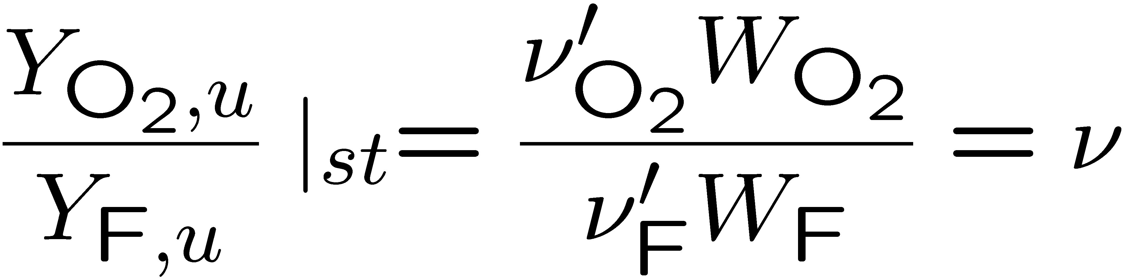
The Eddy Dissipation Model takes the minimum of three rates, those defined with the mean fuel mass fraction with the mean oxidizer mass fraction
and with the product mass fraction
in order to calculate the mean chemical source term.
A and B are modeling constants and ν is the stoichiometric oxygen to fuel mass ratio defined by
3.-17

Slide 18
The Eddy Break-Up model and its modifications are based on intuitive arguments.
The main idea is to replace the chemical time scale of an assumed one-step reaction by the turbulent time scale τ = k/ε.
Thereby the model eliminates the influence of chemical kinetics, representing the fast chemistry limit only.
When these models are used in CFD calculations, it turns out that the constants
C_{EBU} or A and B must be "tuned" within a wide range in order to obtain
reasonable results for a particular problem.
3.-18

Slide 19
The Pdf Transport Equation Model
Similar to moment methods, models based on a pdf transport equation for the velocity and the reactive scalars are usually formulated for one-point statistics.
Within that framework, however, they represent a general statistical description of turbulent reacting flows, applicable to premixed, nonpremixed and partially premixed combustion.
A joint pdf transport equation for the velocity and the reactive scalars can be derived, which is equivalent to an infinite hierarchy of one-point moment
equations for these quantities, Pope (1990).
3.-19

Slide 20
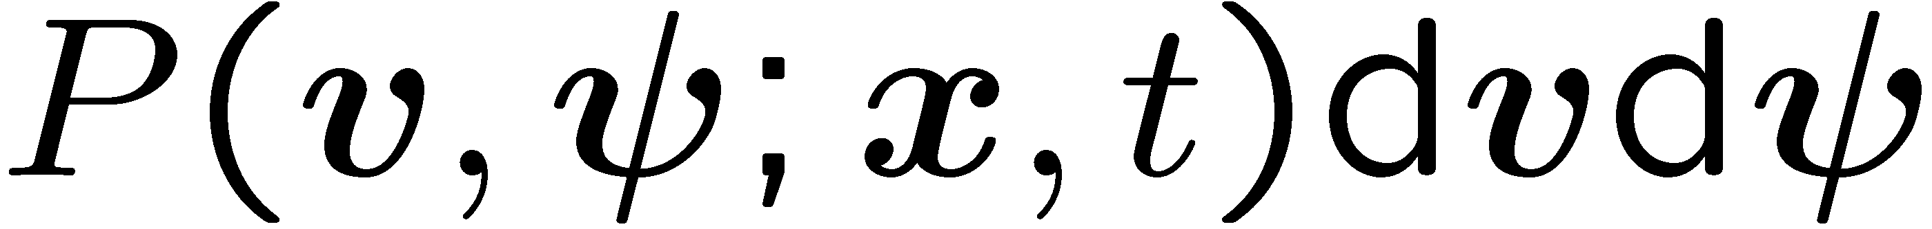
For simplicity, we will consider here the transport equation for the joint pdf of velocity and reactive scalars only.
Denoting the set of reactive scalars, such as the temperature and the mass fraction of reacting species by the vector ψ,
is the probability of finding at point x and time t the velocity components and the reactive scalars within the intervals
3.-20

Slide 21
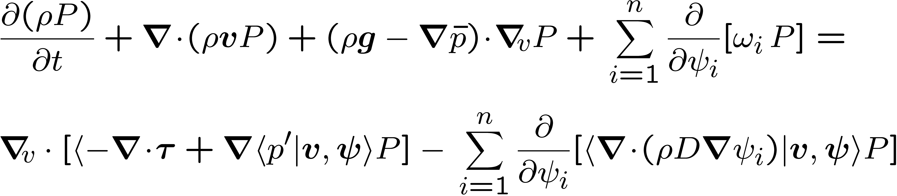
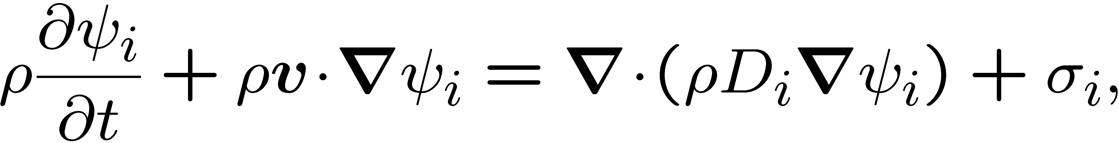
There are several ways to derive a transport equation for the probability density
P(v, ψ ; x, t) (cf. O'Brien, 1980) .
We refer here to the presentation in Pope (1985, 2000), but write the convective terms in conservative form
In deriving this equation, the equations for all reactive scalars, including that
for temperature this equation have been cast into the form
for simplicity.
3.-21

Slide 22

The symbol denotes the divergence operator with respect to the three components of velocity.
The angular brackets denote conditional averages, conditioned with respect to fixed values of v and ψ .
For simplicity of presentation we do not use different symbols for the random
variables describing the stochastic fields and the corresponding sample space
variables which are the independent variables in the pdf equation.
3.-22

Slide 23
The first two terms on the l.h.s. of
are the local change and convection of the probability density function in physical space.
The third term represents transport in velocity space by gravity and the mean pressure gradient.
The last term on the l.h.s. contains the chemical source terms.
All these terms are in closed form, since they are local in physical space.
3.-23

Slide 24
Note that the mean pressure gradient does not present a closure problem, since the pressure is calculated independently of the pdf equation using the mean velocity field.
For chemical reacting flows it is of particular interest that the chemical source terms can be treated exactly for arbitrarily complex chemical kinetics.
It has often been argued that in this respect the transported pdf formulation has a considerable advantage compared to other formulations.
3.-24

Slide 25
However, on the r.h.s. of the transport equation
there are two terms that contain gradients of quantities conditioned on the values of velocity and composition.
Therefore, if gradients are not included as sample space variables in the pdf
equation, these terms occur in unclosed form and have to be modeled.
3.-25

Slide 26
The first unclosed term on the r.h.s. describes transport of the probability density function in velocity space induced by the viscous stresses and the fluctuating pressure gradient.
The second term represents transport in reactive scalar space by molecular fluxes.
This term represents molecular mixing.
3.-26

Slide 27
When chemistry is fast, mixing and reaction take place in thin layers where molecular transport and the chemical source term balance each other.
Therefore, the closed chemical source term and the unclosed molecular mixing term, being leading order terms in a asymptotic description of the flame structure, are closely linked to each other.
Pope and Anand (1984) have illustrated this for the case of premixed turbulent
combustion by comparing a standard pdf closure for the molecular mixing term with a formulation, where the molecular diffusion term was combined with the chemical source term to define a modified reaction rate.
3.-27

Slide 28
From a numerical point of view, the most apparent property of the pdf transport
equation is its high dimensionality.
Finite-volume and finite-difference techniques are not very attractive for this type of problem, as memory requirements increase roughly exponentially with dimensionality.
Therefore, virtually all numerical implementations of pdf methods for turbulent reactive flows employ Monte-Carlo simulation techniques (cf. Pope, 1981, 1985),
The advantage of Monte-Carlo methods is that their memory requirements depend only linearly on the dimensionality of the problem.
3.-28

Slide 29
Monte-Carlo methods employ a large number, N, of particles.
In the Lagrangian algorithm (Pope, 1985)) the particles are not bound to grid nodes.
Instead, each particle has its own position and moves through the computational domain with its own instantaneous velocity.
The particles should be considered as different realizations of the turbulent reactive flow problem under investigation.
The state of the particle is described by its position and velocity, and by the values of the reactive scalar that it represents as a function of time.
These particles should not be confused with real fluid elements, which behave similarly in a number of respects.
3.-29

Slide 30
The Laminar Flamelet Concept
The view of a turbulent diffusion flame as an ensemble of stretched laminar flamelets is due to Williams (1975).
Flamelet equations based on the mixture fraction as independent variable, using
the scalar dissipation rate for the mixing process, were independently derived by
Peters (1980) and Kuznetsov (1982).
A first review of diffusion flamelet models was given by Peters (1984).
For premixed and diffusion flames the flamelet concept was reviewed by Peters (1986) and Bray and Peters (1994).
3.-30

Slide 31
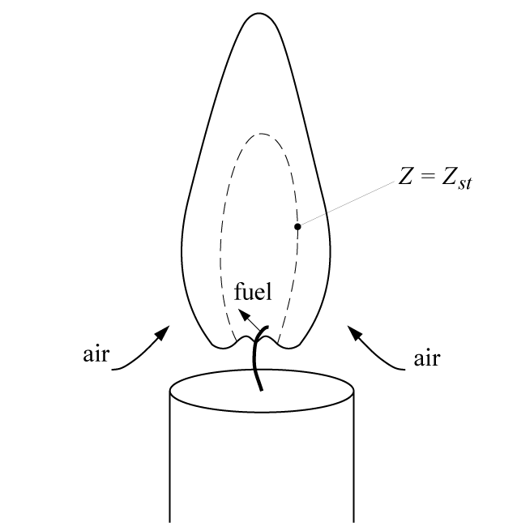
Flamelets are thin reactive-diffusive layers embedded within an otherwise non-reacting turbulent flow field.
In diffusion flames they are located in the vicinity of the surface of
stoichiometric mixture.
Here the temperature reaches values
that are close to the maximum temperature
and the reactions become very fast.
3.-31

Slide 32
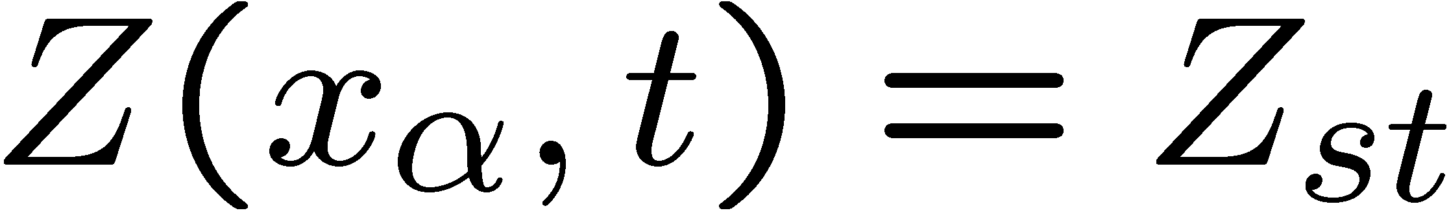
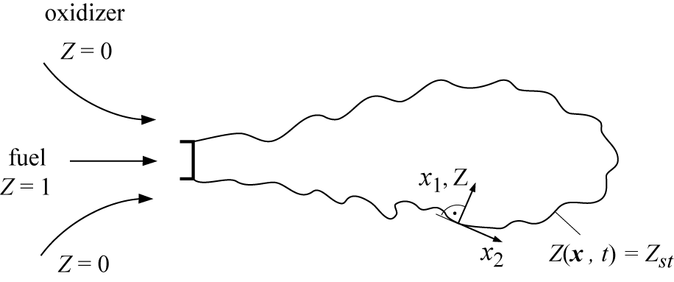
Then the surface of the stoichiometric mixture can be determined from
Combustion occurs in a thin layer in the vicinity
of this surface if the local mixture fraction gradient
is sufficiently high.
Let us locally introduce an
orthogonal coordinate system
x₁, x₂, x₃ attached to the surface
of stoichiometric mixture.
x₁ points normal to the surface Z_{st} , x₂ and x₃ lie within the surface.
3.-32

Slide 33
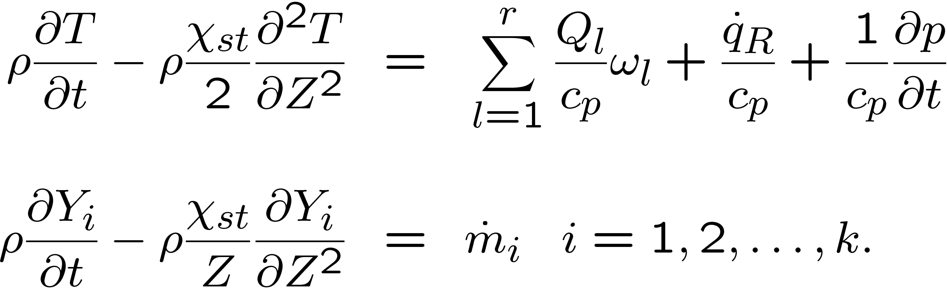
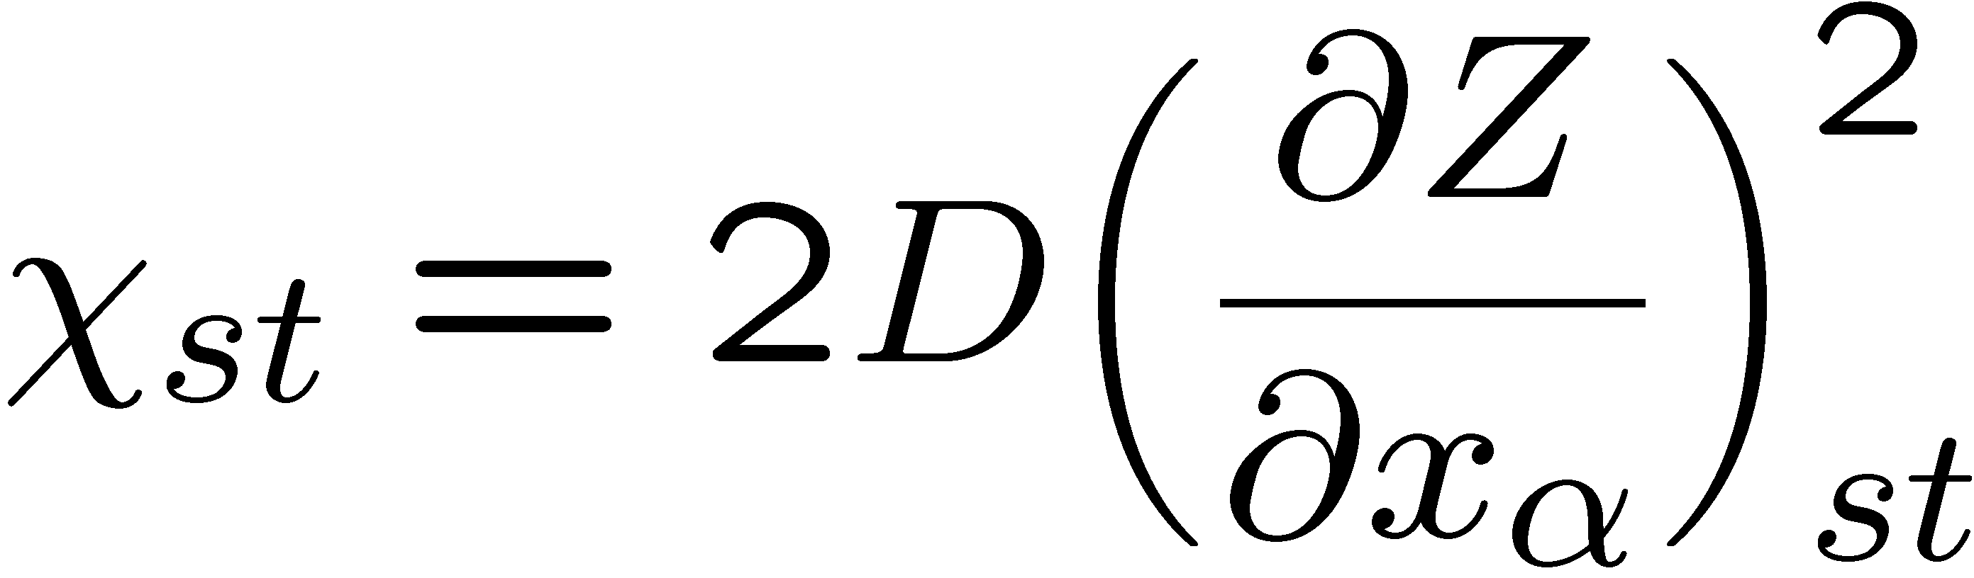
Introducing this coordinate transformation into the temperature and the species equation, one obtains to leading order the one-dimensional time-dependent equations
Here
is the instantaneous scalar dissipation rate at stoichiometric conditions.
It has the dimension 1/s and may be interpreted as the inverse of a characteristic diffusion time.
It may depend on t and Z and acts as a prescribed parameter, representing the flow and the mixture field.
3.-33

Slide 34
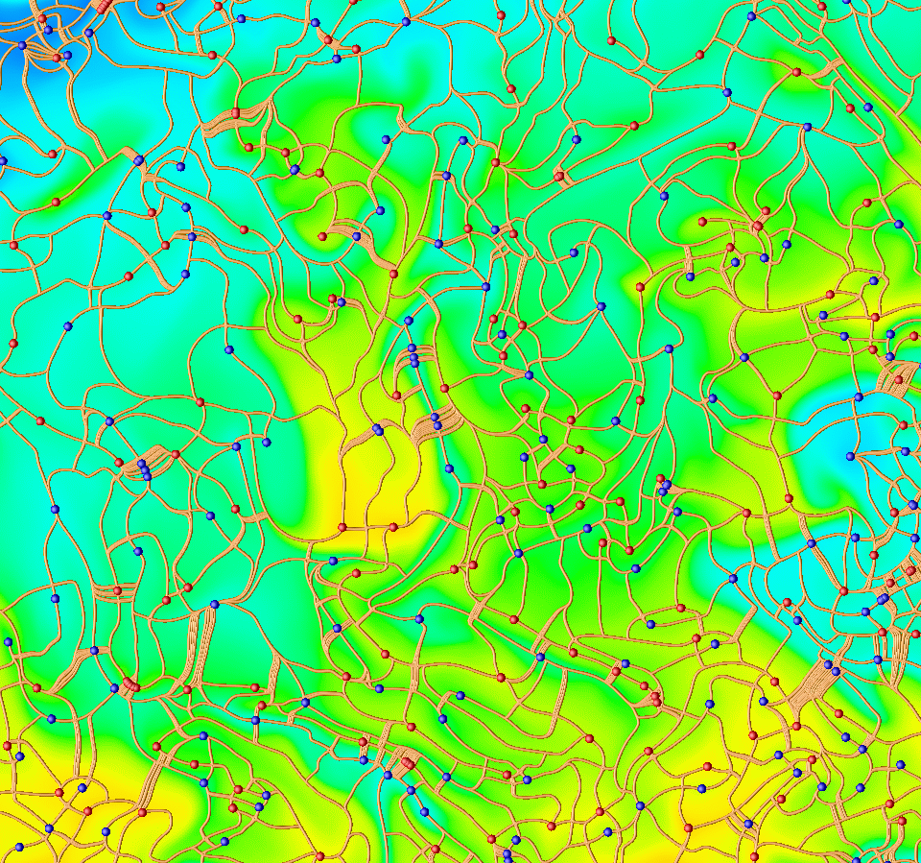
Since the chemical time scale of this reaction is short, chemistry is active only within a thin layer. This layer is thin compared to the size of a Kolmogorov eddy.
Therefore it is embedded within the quasi-laminar flow field of such an eddy and the assumption of a laminar flamelet structure is justified.
Decomposition of the mixture fraction
field into dissipation elements
3.-34

Slide 35
The location of the flame surface in premixed and diffusion flames in the flamelet concept
Differently from moment methods or methods based on a pdf transport equation, statistical considerations in the flamelet concept focus on the location of the flame surface and not on the reactive scalars themselves.
That location is defined as an iso-surface of a non-reacting scalar quantity, for
which a suitable field equation is derived.
For nonpremixed combustion the mixture fraction Z is that scalar quantity, for premixed combustion the scalar G will be introduced.
3.-35

Slide 36
Once equations that describe the statistical distributions of the scalar quantities Z and G are solved, the profiles of the reactive scalars normal to the surface are calculated using flamelet equations.
These profiles are assumed to be attached to the flame surface and are convected with it in the turbulent flow field.
The assumption therefore is that there is a one-to-one ‘mapping’ of reactive scalar fields, such as the temperature and the mass fractions, on the underlying field of the respective scalar quantity Z or G.
Therefore the statistical moments of the reactive scalars can be obtained from the statistical distribution of the scalar quantities Z and G.
3.-36

Slide 37
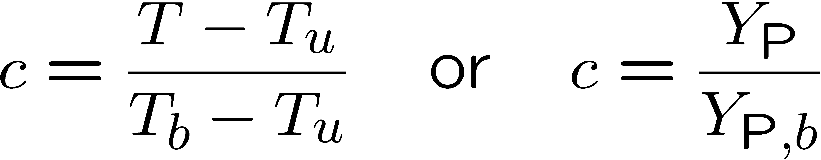
The BML-Model and the Coherent Flamelet Model
For premixed combustion, flamelet models are typically based on the progress
variable c.
The progress variable c is defined as a normalized temperature or normalized product mass fraction
which implies a one-step reaction A to P and a corresponding heat release raising the temperature from T_{u} to T_{b}.
In flamelet models based on the progress variable the flame structure is assumed to be infinitely thin and no intermediate values of temperature are resolved.
This corresponds to the fast chemistry limit.
3.-37

Slide 38
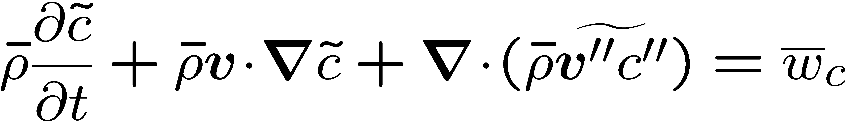
The progress variable therefore is a step function that separates unburnt mixture and burnt gas in a given flow field.
The classical model for premixed turbulent combustion, the Bray-Moss-Libby (BML) model, was initiated by Bray and Moss (1977) by assuming the pdf of the progress variable c to be a two delta function distribution.
This assumption only allows for entries at c = 0 and c = 1 in a turbulent premixed flame, but it illustrates important features, like counter-gradient diffusion of the progress variable.
This appears in the equation for the Favre mean progress variable
where the molecular diffusion term has been neglected.
3.-38

Slide 39
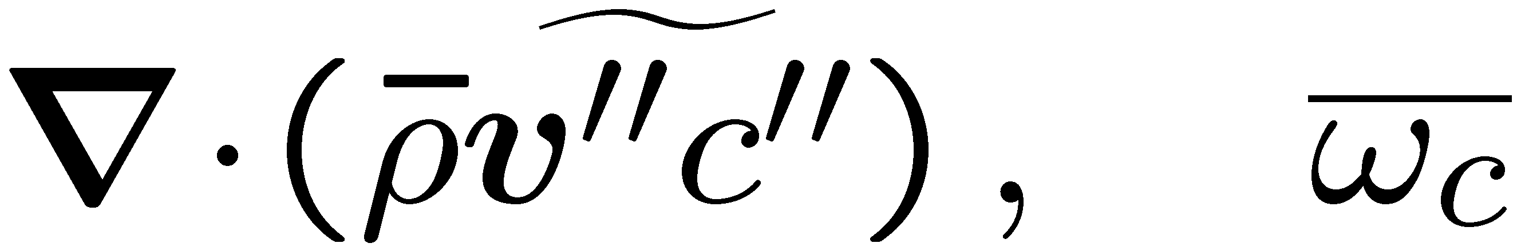
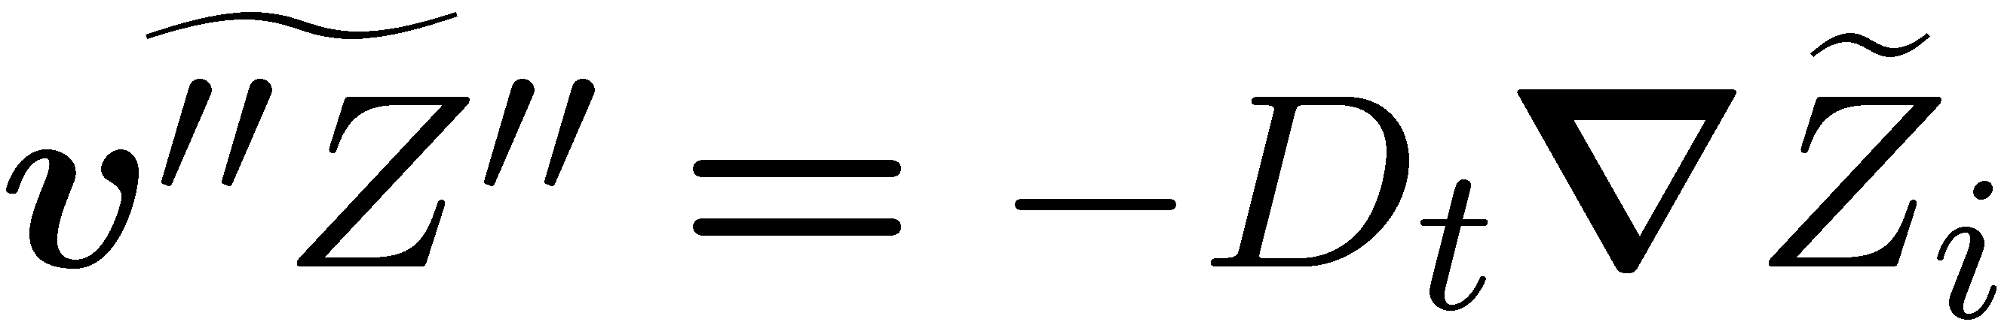
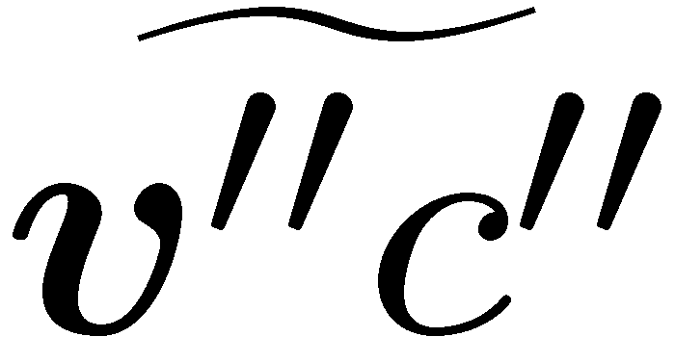
This equation
requires the modeling of the turbulent transport term and the mean reaction term
Libby and Bray (1981) and Bray et al. (1981) have shown that a gradient
transport assumption like
is not applicable to .
This is due to gas expansion effects at the flame surface and is called counter-gradient diffusion.
3.-39

Slide 40
Counter-gradient diffusion has been found in many experiments and in many one-dimensional numerical analyzes.
However, there is no model available that could be used in three-dimensional calculations solving
With counter-gradient diffusion included.
Models for the mean reaction rate by Bray et al.(1984) and Bray and Libby (1986) focus on a time series of step function events of the progress variable.
This makes the mean source term proportional to the flamelet crossing frequency.
3.-40

Slide 41
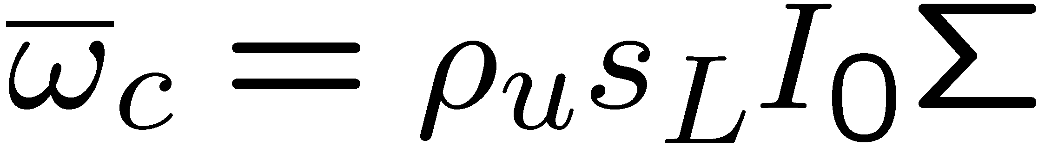
Further modeling, discussed in more detail in Bray and Libby (1994), then leads to the expression
where s_{L} is the laminar burning velocity, I₀ is a stretch factor and Σ is the flame surface density (flame surface per unit volume).
A model for Σ has been proposed by Candel et al. (1990).
This is called the Coherent Flame Model (CFM).
3.-41

Slide 42
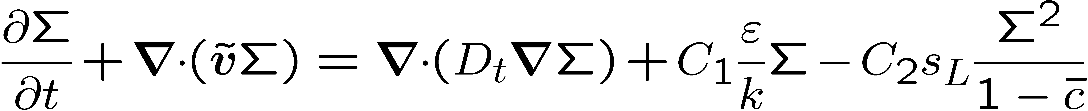
A comparison of the performance of different formulations of the model for one-dimensional turbulent flames was made by Duclos et al. (1993).
Modeling based on DNS data has led Trouve and Poinsot (1994) to the following
equation for the flame surface density Σ:
The terms on the l.h.s. represent the local change and convection, the first term on the r.h.s. represents turbulent diffusion, the second term production by flame stretch and the last term flame surface annihilation.
The stretch term is proportional to the inverse of the integral time scale τ = k/ε which is to be evaluated in the unburnt gas.
3.-42

Slide 43
Combustion Models used in Large Eddy Simulation (LES)
Turbulence models based on Reynolds Averaged Navier-Stokes Equations
(RANS) employ turbulent transport approximations with an effective turbulent
viscosity that is by orders of magnitude larger than the molecular viscosity.
In particular if steady state versions of these equations are used, this tends to suppress large scale instabilities which occur in flows with combustion even more frequently than in non-reacting flows.
If those instabilities are to be resolved in numerical simulations, it is necessary to recur to more advanced, but computationally more expensive methods such as Large Eddy Simulation (LES).
3.-43

Slide 44
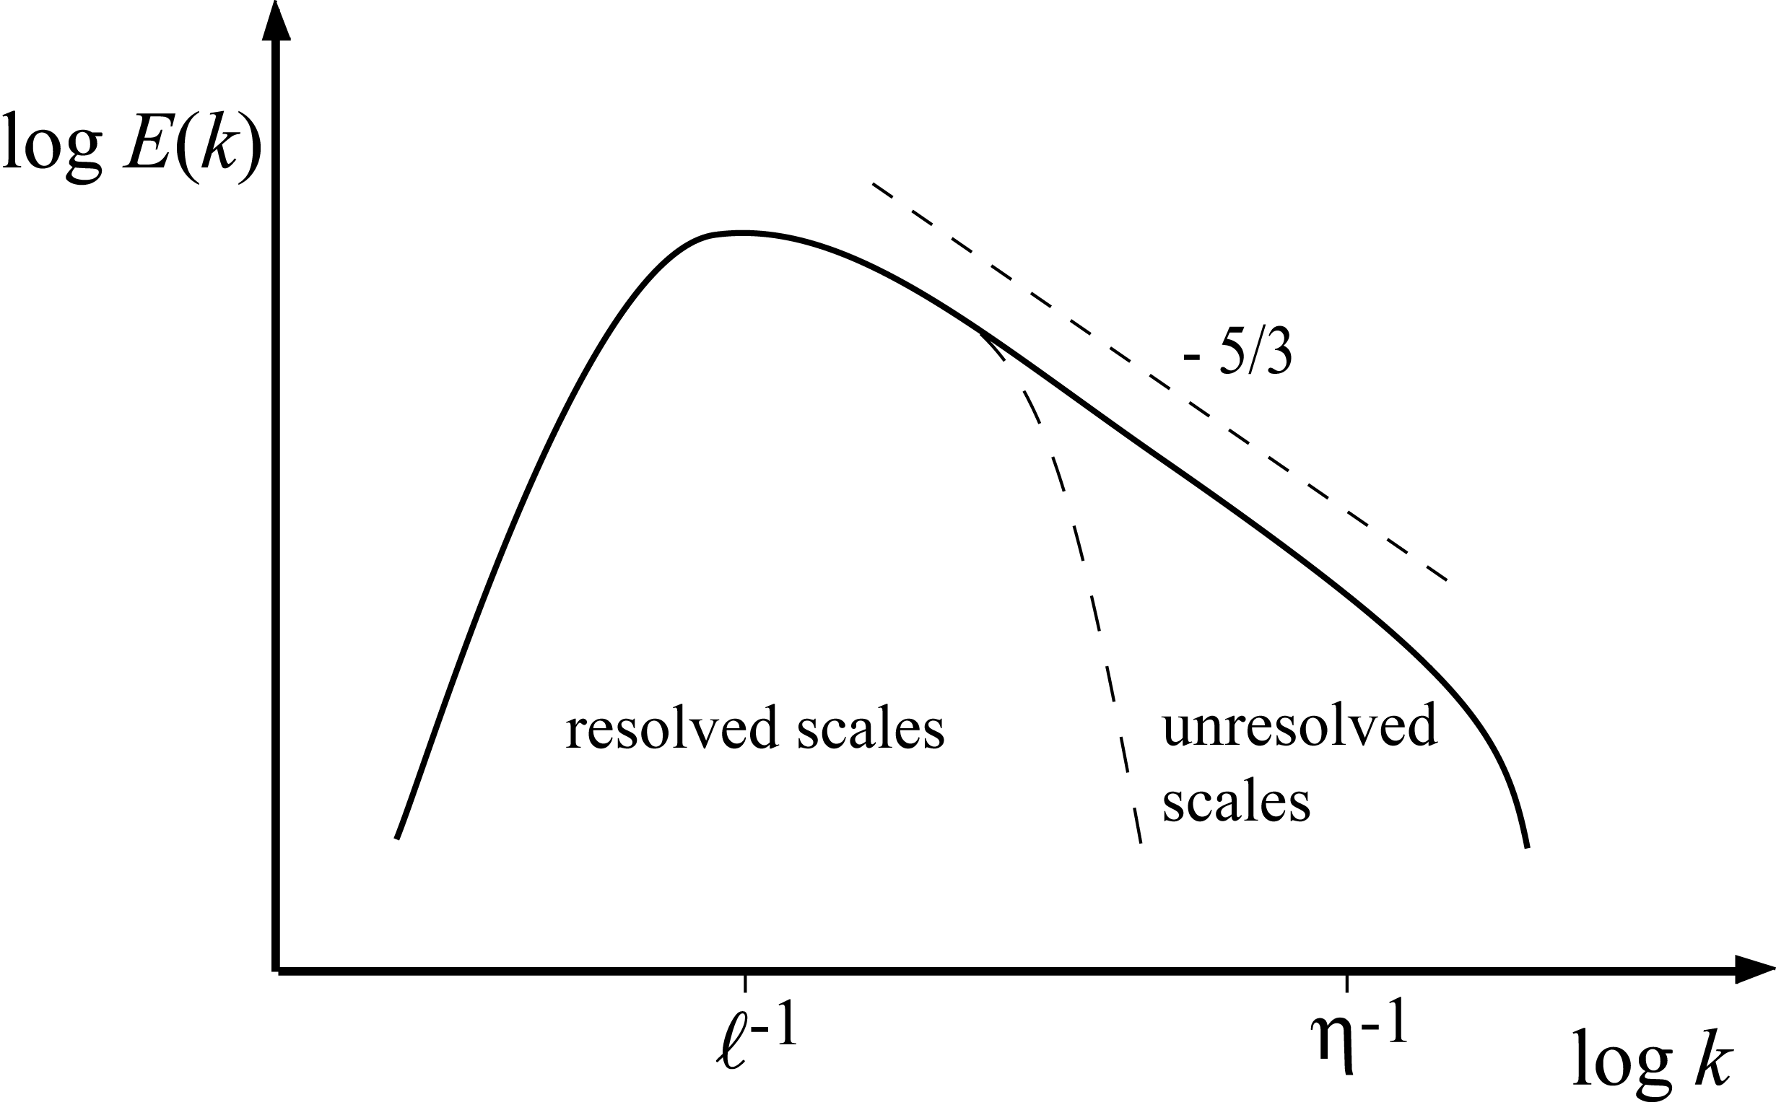
Large Eddy Simulation does not intend to numerically resolve all turbulent length scales, but only a fraction of the larger energy containing scales within the inertial subrange.
Modeling is then applied to represent the smaller unresolved scales which contain only a small fraction of the turbulent kinetic energy.
3.-44

Slide 45
Therefore the computed flows are usually less sensitive to modeling assumptions.
The distinction between the resolved large scales and the modeled small scales is made by the grid resolution that can be afforded.
The model for the smaller scales is called the subgrid model.
In deriving the basic LES equations, the Navier-Stokes equations are spatially filtered with a filter of size Δ, which is of the size of the grid cell (or a multiple thereof) in order to remove the direct effect of the small scale fluctuations (cf. Ghosal and Moin, 1995).
These show up indirectly through nonlinear terms in the subgrid-scale stress tensor as subgrid-scale Reynolds stresses, Leonard stresses, and
subgrid-scale cross stresses.
3.-45

Slide 46
The latter two contributions result from the fact that, unlike with the traditional Reynolds averages, a second filtering changes an already filtered field.
The reason why LES still provides substantial advantages for modeling turbulent
combustion is that the scalar mixing process is of paramount importance in chemical conversion.
Nonreactive and reactive system studies show that LES predicts the scalar
mixing process and dissipation rates with considerably improved accuracy compared to RANS, especially in complex flows.
3.-46

Slide 47
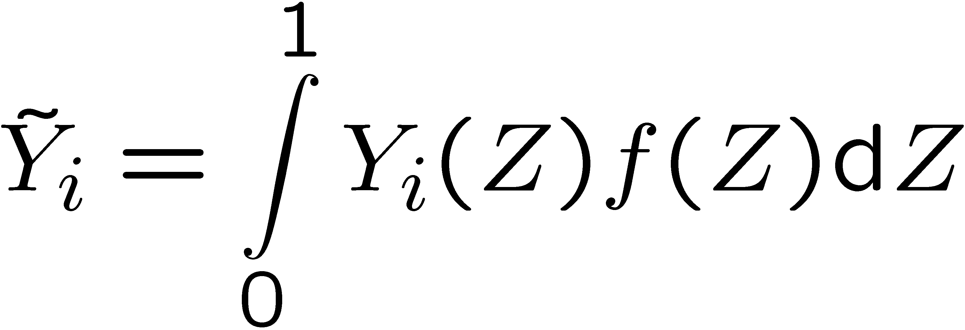
Considering the simplest case of infinitely fast chemistry, all species mass fractions and the temperature are a function of mixture fraction only.
If the subfilter probability distribution of the mixture fraction is known,
the Favre-filtered mass fractions, for instance, can then be obtained as
where Z is the mixture fraction and f (Z) is the marginal density-weighted filter
probability density function (FPDF) of the mixture fraction.
Applications of simple conserved scalar models in LES have been based on infinitely fast irreversible chemistry Pierce (1998) and equilibrium chemistry Cook (1994}.
3.-47

Slide 48
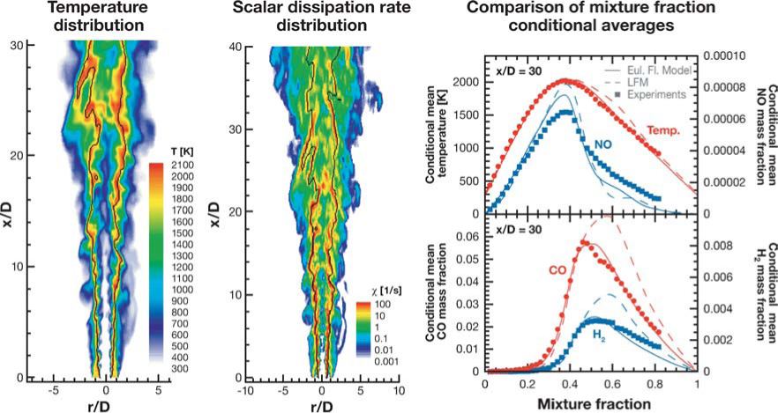
Results from large-eddy simulation of Sandia flame D (Pitsch, 2002,2000), using the Eulerian flamelet model (solid lines) and the Lagrangian flamelet model (dashed lines) compared with experimental data of Barlow (1998). Temperature distribution (left), scalar dissipation rate distribution (center), and comparison of mixture fraction–conditioned averages of temperature and mass fractions of NO, CO, and H₂ at x/D = 30. Courtesy of Pitsch (2006)
3.-48

Slide 49
The resolved scalar dissipation rate field is dominated by features occurring on the large scale of the turbulence. Layers of high dissipation rate alternate with low dissipation rate regions.
In the LFM results, as well as in several earlier RANS-type modeling
studies Barlow (2000), where these fluctuations are not considered, some heat
release occurs on the rich partially premixed side of the flame, which leads to strong CO formation in these regions.
Accounting for the richness of the predicted spatial distribution of the scalar dissipation rate substantially improves the comparison with the experimental data by suppressing the heat release in the rich regions, and hence the formation of CO.
3.-49

Slide 50
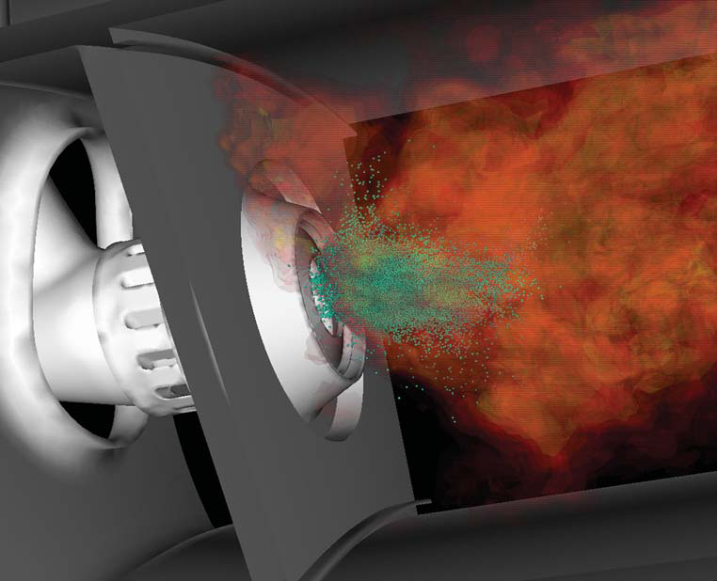
The figure shows the spray and temperature distribution computed from LES and demonstrates the complexity of the geometry and the associated flow physics.
3.-50

